Slide 1

Semantic Annotation of
Service Level Agreement
OGF25/EGEE User Forum
Catania, Italy
March 5 2009
GRAAP-WG
A lightweight annotation approach of WS-Agreement based specifications
Ioannis Kotsiopoulos – The University of Manchester
ioannis@cs.man.ac.uk

Slide 2

OGF IPR Policies Apply
“I acknowledge that participation in this meeting is subject to the OGF Intellectual Property Policy.”
Intellectual Property Notices Note Well: All statements related to the activities of the OGF and addressed to the OGF are subject to all provisions of Appendix B of GFD-C.1, which grants to the OGF and its participants certain licenses and rights in such statements. Such statements include verbal statements in OGF meetings, as well as written and electronic communications made at any time or place, which are addressed to:
    the OGF plenary session,
    any OGF working group or portion thereof,
    the OGF Board of Directors, the GFSG, or any member thereof on behalf of the OGF,
    the ADCOM, or any member thereof on behalf of the ADCOM,
    any OGF mailing list, including any group list, or any other list functioning under OGF auspices,
    the OGF Editor or the document authoring and review process
Statements made outside of a OGF meeting, mailing list or other function, that are clearly not intended to be input to an OGF activity, group or function, are not subject to these provisions.
Excerpt from Appendix B of GFD-C.1: ”Where the OGF knows of rights, or claimed rights, the OGF secretariat shall attempt to obtain from the claimant of such rights, a written assurance that upon approval by the GFSG of the relevant OGF document(s), any party will be able to obtain the right to implement, use and distribute the technology or works when implementing, using or distributing technology based upon the specific specification(s) under openly specified, reasonable, non-discriminatory terms. The working group or research group proposing the use of the technology with respect to which the proprietary rights are claimed may assist the OGF secretariat in this effort. The results of this procedure shall not affect advancement of document, except that the GFSG may defer approval where a delay may facilitate the obtaining of such assurances. The results will, however, be recorded by the OGF Secretariat, and made available. The GFSG may also direct that a summary of the results be included in any GFD published containing the specification.”
OGF Intellectual Property Policies are adapted from the IETF Intellectual Property Policies that support the Internet Standards Process.
Notes:
IPR Notices Note Well for OGF meetings

Slide 3
Presentation Outline
Motivation, problem area
Proposed Specification Objectives
Annotation Mechanisms
Annotating WS-Agreement Documents
WS-Agreement Support

Slide 4
SLA Context
Contract in the market between customer providers required to protect both customers and providers in the process of service trading
The Service Level Agreement is a legal relationship between the two and forms part of a legally binding contract.
  Information specified in the SLA:
    Terms for the provision of the service (service description)
    Quality of service (QoS) level to be maintain
    Information about resources to be provided
    The liability to compensation if SLAs are not met.
The contract is the result of a negotiation process between both parties about
WS Agreement standard which defines the SLA specification and the templates required for negotiation
Open marketplace: Providers and consumers are collaborating on a global scale competing for offering and consuming services
  Entities can enter in the market without any predefined agreement

Slide 5
Motivation
WS-Agreement covers the syntactic aspects of the protocol definition for the establishment of agreement between two parties
  a schema for specifying an agreement,
  a schema for specifying an agreement template, and a set of port types and
  operations for managing agreement life-cycle, including creation, expiration, and monitoring of agreement states.

Slide 6
WS-Agreement Non-Goals
Quote from WS-Agreement spec (Section 1.1.2 page 6)
Defining specific service level objective terms for a specific usage domain such as network, server, applications, etc.
Defining Specification of metrics associated with agreement parameters i.e., how and where these are measured
Specification assumes that other complimentary specifications will address these requirements

Slide 7
Semantic Annotation of SLAs
What is a Semantic Annotation?
What does it bring into the table?
Does everyone has to use them? What happens if my tool fails to deal with them?
Can I see an example?

Slide 8
What is a Semantic Annotation?
It is a reference to conceptual model - ontology
Conceptual Model/Ontology
  An agreed upon model that captures the semantics of domain
  Common Nomenclature
  Domain Knowledge (facts)
Using this “link” we can get richer semantic information about a concept defined outside WS-Agreement
Formal semantics allow machines to interpret the meaning of a concept

Slide 9
What do Semantics bring into the table?
Improved interoperability between service providers and clients
  Beyond syntax to semantics, mapping of data exchanged between the negotiating parties (very time consuming without semantics, just as XML in WS-Agreement gives syntactic interoperability, SA-SLA gives semantic interoperability)
Increased automation in certain tasks where precise understanding of metadata is required i.e. SLA negotiation

Slide 10
Does everyone have to use them?
No!
Annotation Styles
  Intrusive: require modification of XML schema
  Non-intrusive: use extensibility point of XML schema
    Semantic Annotations for WSDL and XML Schema (SAWSDL)
    SAWSDL is a W3C recommendation and in stable format
SA-SLA Specification is backward compatible
  If annotation is found then extra reasoning is feasible
  If NOT then negotiation algorithm continues normal operation

Slide 11

Example
Different languages, different metrics
Provider 1
Coste = 210 €
Disponibilidad: 85%
Tiempo de respuesta 1,5 horas
Negotiation
Customer
Prix < 200 €
Disponibilité > 90%
Temps de réponse < 2,1 heures
Negotiation
Provider 2
Price = 100 €
Availability: 95%
AverageResponseTimeGuarantee: 0.5 seconds

Slide 12
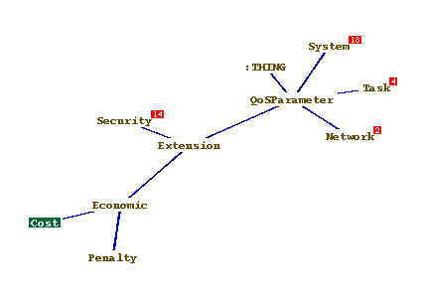
Example of Semantic Annotation
Definition of Quality of Service Metric
  <SLAParameter name="Total Cost" type="double" unit="Euro" satsla:modelReference="http://eu-brein.com/ontology/Upper/QoS#Cost">
      <Metric>Total Cost Metric</Metric>
  </SLAParameter>
The annotation carries a reference to a concept in a semantic model (in this case BREIN Business Ontology) that provides a high level description of a Quality of Service metric which can be interpreted by the Negotiation Broker in a meaningful way.
Agreed Conceptual Model

Slide 13
SA-SLA Tools and Applications
Tools
  SASLA4j library: To work with SA-SLA files
  SASLA processing: Algorithm to value SLA template offers with respect to customers’ requirements
  SA-SLA GUI: Tool to create WS-Agreement templates and annotate by SA-SLA specification
  SA-SLA repository
Applications
  Service and Resource Selection
    Based on non-functional properties specified in the SLA templates annotated with SA-SLA
  Semantic enabled Negotiation

Slide 14
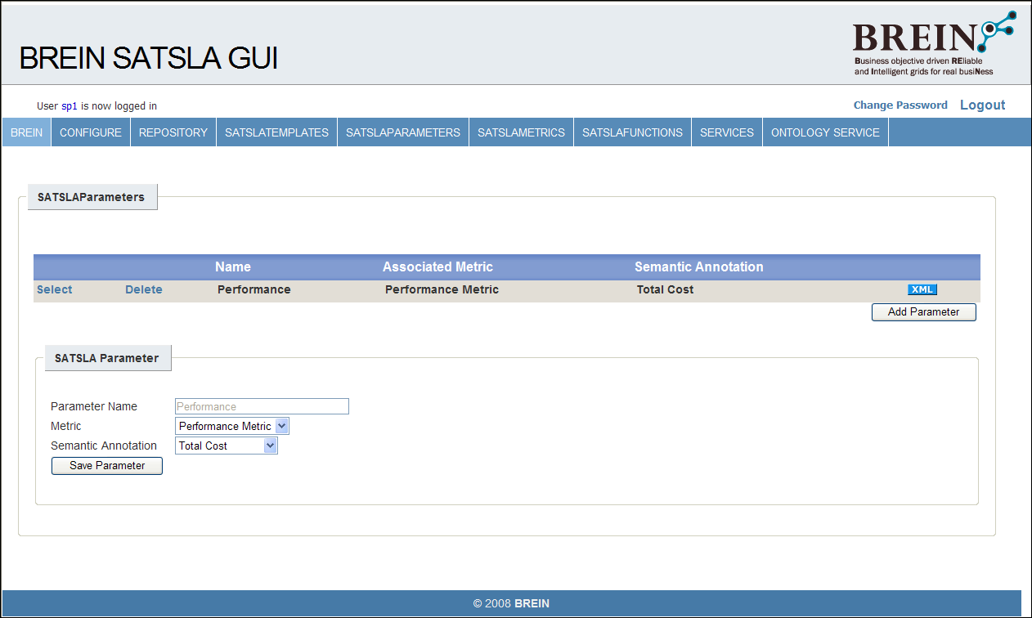
Annotation tool I

Slide 15
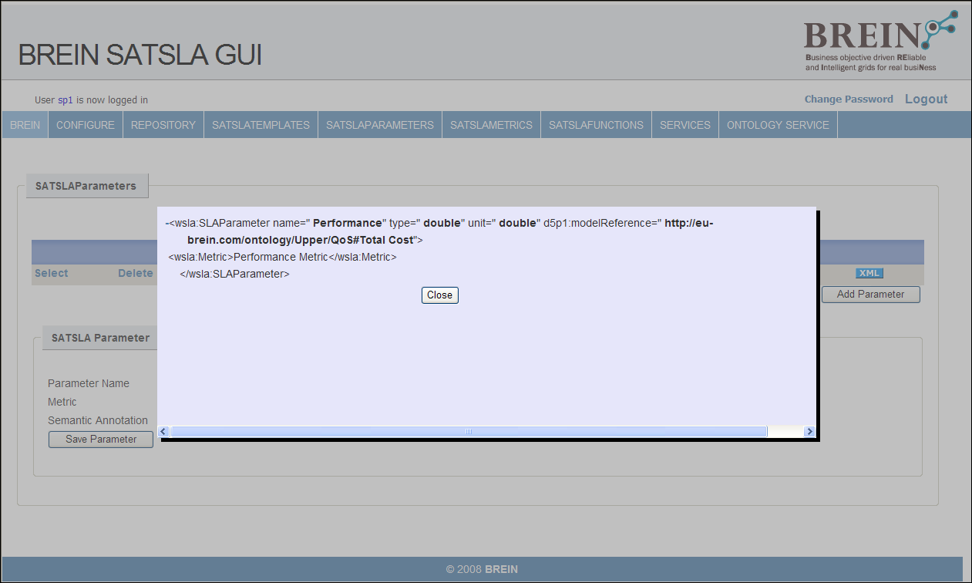
Annotation tool II

Slide 16
SLA Template Selector

Slide 17
Conclusion and outlook
Proposed specification can address certain interoperability issues during automated negotiation of SLAs
Using semantic technologies in a non-intrusive way addresses the issue of backwards compatibility and eases development of tools
Our proposal is based on existing standards (WS-Agreement, Trustcom, SAWSDL)
Proposed specification can be released within 2009
Supporting toolkit is under development
  Some components are already complete
  Ontologies will be released to the community

Slide 18
Thank you for listening
Any questions?
Acknowledgements
Acknowledgements
Henar Munoz Frutos (TID), Bastian Koller (HLRS)
Ignacio Soler Jubert (ATOS)
The Semantic Group of the BREIN Consortium
John Brooke and Carole Goble (University of Manchester)

Slide 19
Full Copyright Notice
Copyright (C) Open Grid Forum (applicable years). All Rights Reserved.
This document and translations of it may be copied and furnished to others, and derivative works that comment on or otherwise explain it or assist in its implementation may be prepared, copied, published and distributed, in whole or in part, without restriction of any kind, provided that the above copyright notice and this paragraph are included on all such copies and derivative works.
The limited permissions granted above are perpetual and will not be revoked by the OGF or its successors or assignees.
Notes:
OGF Full Copyright Notice if necessary

